Slide 1
WOODLAWN ECO-PRECINCT
COMMUNITY LIAISON COMMITTEE MEETING
28th August 2025

Slide 2
ACKNOWLEDGEMENT
OF COUNTRY
Veolia acknowledges Ngunnawal people as the traditional custodians of the lands and waters in which we live and work and their continuing connection to land, water and community. We pay respects to their Elders past, present and emerging and any first nations people present here today.
Notes:
Veolia acknowledges Ngunnawal people as the traditional custodians of the lands and waters in which we live and work and their continuing connection to land, water and community. We pay respects to their Elders past, present and emerging and any first nations people present here today.
Welcome and thank you. Effective community consultation is a participation process that underpins genuine community development. The purpose of the Woodlawn Community Liaison Committee is to help us better understand what the community values and keep us informed of issues that the community finds important so we can provide feedback and continually improve our processes.

Slide 3
MEETING AGENDA
ITEM | TOPIC
1 | Introduction and welcome
2 | Apologies
3 | Actions from previous meeting
4 | Eco-Precinct Update Operations Environmental Compliance Update
5 | ARC presentation
6 | Veolia’s response to latest EPA water monitoring results
7 | Any other business ● Date for next meeting
8 | Meeting Close

Slide 4
INTRODUCTION
AND WELCOME

Slide 5
MEETING ATTENDANCE/APOLOGIES
DATE | Thursday 3rd July 2025 | Time | 5:00pm to 7.00pm
LOCATION | Woodlawn Conference Room 619 Collector Road, Tarago Inv = Invited Guest
NAME | PRESENT | NAME | PRESENT
Jamie Seaton (JS) (Chair) |  | Carmen Leocherer (CL) (Veolia representative) | Yes
CR Keith Smith (KS) (GMC Councillor) |  | Scott Martin (SM) (GMC Director Planning & Environment) - Inv
Cr John Preston (JP) (QPRC Councillor) |  | Alvin Stone (AV) (Veolia Public Relations Manager) - Inv | Yes
Fiona Jeffery (FJ) (Community Rep) |  | Clara Ng (CN) (Veolia Strategic Development Manager) - Inv | Yes
Lois Wake (TADPAI Rep) |  | Max Rixe (MR) (Rixie group) - Inv | Yes
Dr Samantha Johnson (SJ) (Community Rep) |  | Megan Surawski (MS) (Veolia Head of Government Relations) - Inv | Yes
Tom Martin (TM) (Community Rep)
Andrew Warner (AW) (Veolia representative) | Yes
Justin Houghton (JH) (Veolia representative) | Yes

Slide 6
ACTIONS FROM LAST MEETING

Slide 7
MEETING ACTIONS
ITEM | ACTION | ASSIGNED TO
1 | ACTION: Veolia to consider request to make the following modifications to Woodlawn website: • Update website to include names of members • Organise documents on the website according to the month of production and ensure the document at the top of the documents list is meeting minutes UPDATE: Completed | LB (Veolia)
2 | ACTION: Determine status of EPA water sampling program in local creeks. (note CL’s response post CLC meeting #22 is that CLC members should contact EPA themselves to obtain advice about EPA activities). UPDATE: Covered in presentation today | CL (Veolia)
3 | ACTION: Provide CLC members with presentation slide containing the strategic plan. UPDATE: Completed | AW (Veolia)
4 | ACTION: Develop new conflict of interest provision for the CLC charter for the consideration of members. UPDATE: Provision updated - will be released to CLC (before COB 12 Sept) for review and feedback | AW (Veolia)

Slide 8
ECO-PRECINCT OPERATIONAL UPDATE
Traffic Lights
Attention required
Area of focus
Going well

Slide 9
ECO-PRECINCT
Positive outcomes since last meeting
WINS!
COMMUNITY - In the May 2025 presentations the Veolia Mulwaree Trust gave out $300,000 in projects and $87,000 in the Donations.
  Since 2005 over $15.2 million and 2,000 local projects supported.
WATER MANAGEMENT - All dams continue to reduce further below freeboard - water strategy moving forward.
REGULATORS - Working with EPA on HRA report and next steps.
ODOUR MANAGEMENT IMPROVEMENT - Odour audit showed a significant reduction in odour potential on site through works that were carried out to date - next step is the use of tarps and increased use of biofiltration.

Slide 10
OPERATIONAL UPDATE
PERFORMANCE
Bioreactor Landfill - Licence tonnage
YTD Waste Processed (licence 7 Sep 2024 - 26 August 2025)
Regional Waste 120,229 t - (licence 125,000t)
Sydney Waste 775,535 t - (licence 900,000t)
Both are within licence limits for Sep 2024 - Sep 2025 period
Mechanical Biological Treatment
YTD Waste Processed (licence 22 Dec 2024 - 26th August 2025)
Sydney Waste 89,040.4t - (licence 144,000 t)
MWOO to Bioreactor (ADC) 36,600t
WOO to Tailings Rehabilitation 3,358.7t
  WOO transitioning to ADC odour control
Ferrous Recovery 364.5t
Total diversion from Landfill 40,323.2t
Leachate Treatment Plant
YTD Leachate Treated
Current treatment rate of 4.1 L/s
Average treatment rate YTD 4.06 L/s
Licence requirement >4 L/s

Slide 11
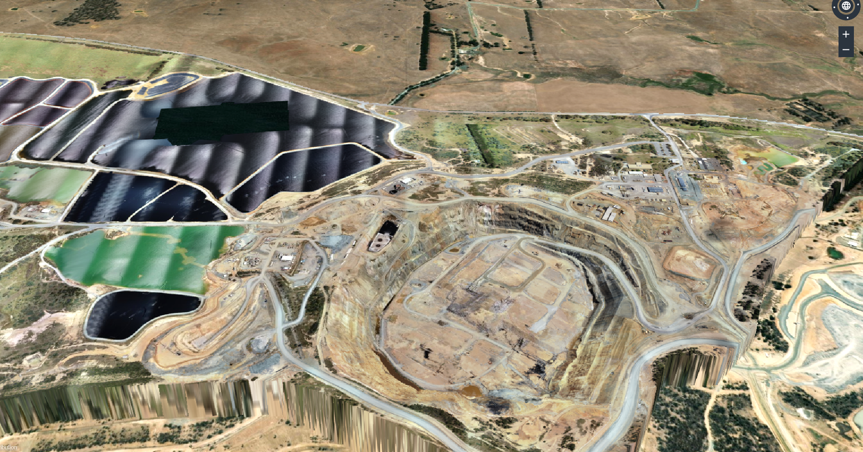
WATER MANAGEMENT
Storage status and location
Coffer Dam #2
ED1
Plant Collection Dam
Coffer Dam #1
Leachate Treatment Plant
Office area
ED3N 1-4
Plant collection catchment
ED3S
ED3SS
Western Ridge catchment
Bioreactor Void catchment

Slide 12
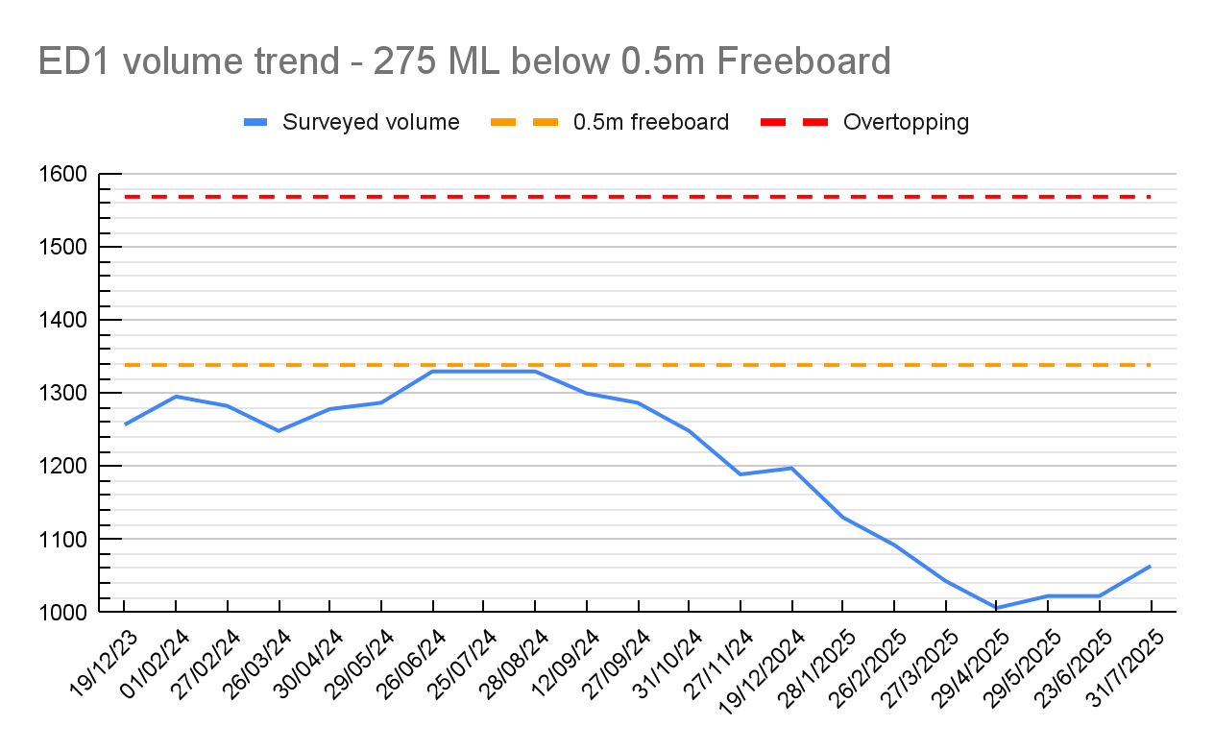
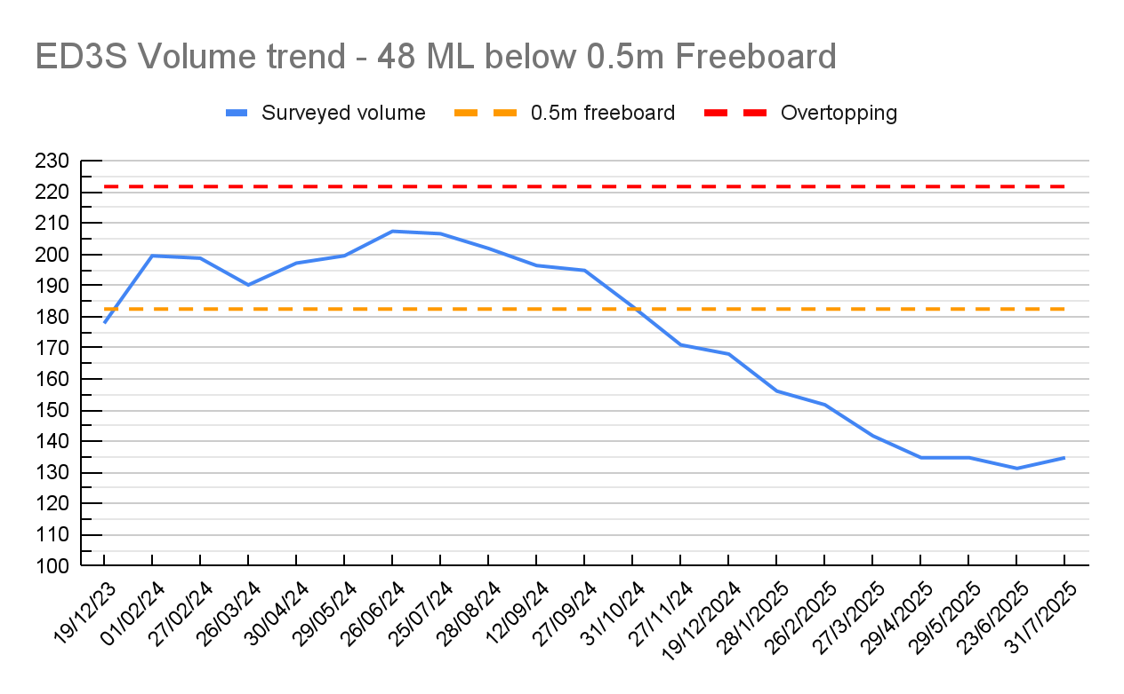
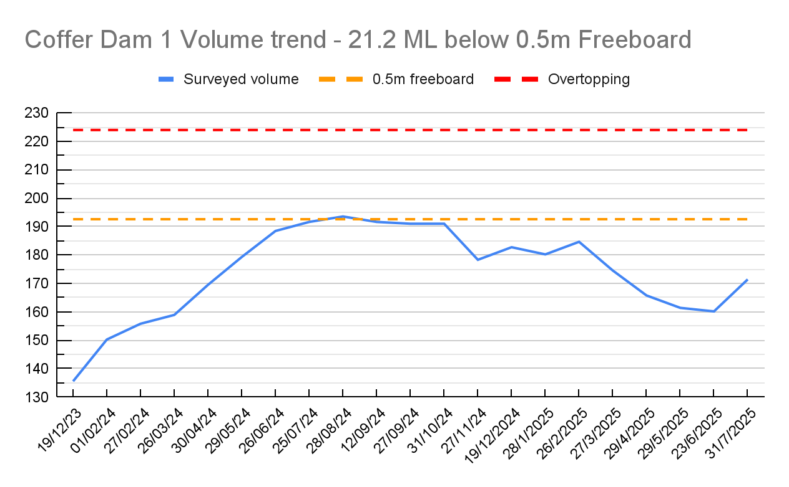
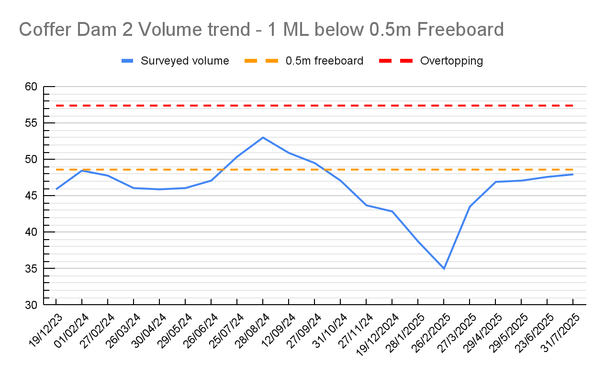
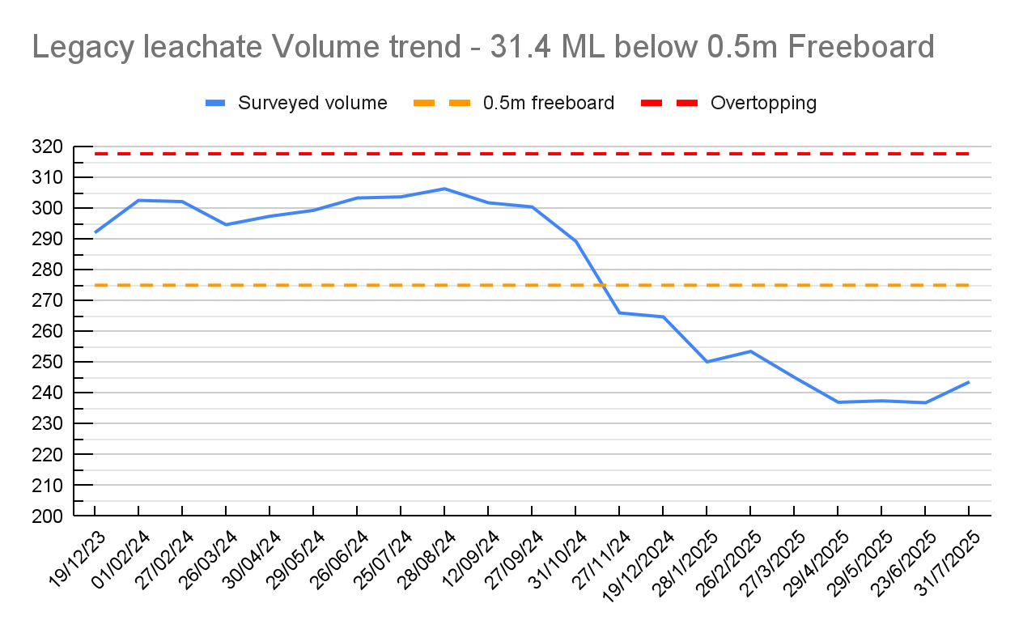
WATER MANAGEMENT
FREEBOARD MANAGEMENT
* Note: 1 L/s = 86,400 L/day @ 20% evaporation = 17,280 L/day
Notes:
As per slide.

Slide 13
WATER MANAGEMENT
TREATED LEACHATE STRATEGY SUMMARY
Short term next 18 months
COMPLETE - Temporary tank farm - 54 ML - 4 installed and approved for use (3 tanks full)
Liner repairs Coffer dam 1 - completed in July (freeing up an extra 30ML capacity)
Temp Tanks - lodged with DPHI to extend post Nov
Permanent tank farm 1 - 54ML - Expecting approval end of this week
Permanent tank farm 2 - up to 108ML - Site investigations underway - Mar 2026
Reverse Osmosis (RO) treatment - Temp plant being commissioned, perm plant in final stages of approval
Long term next 2 to 10 years
Continuing to review current Leachate treatment plant throughput requirements based on weather and leachate predictions
Thermal evaporation trials underway to support a Thermal plant to reduce volume of RO brine - 2027
Note: We produce 345,600L of treated leachate every day. 10 ML of storage volume gives us 30 days of treated leachate storage (eg 48ML = 139 days (4.6 months) of storage)
Notes:
As per slide.

Slide 14
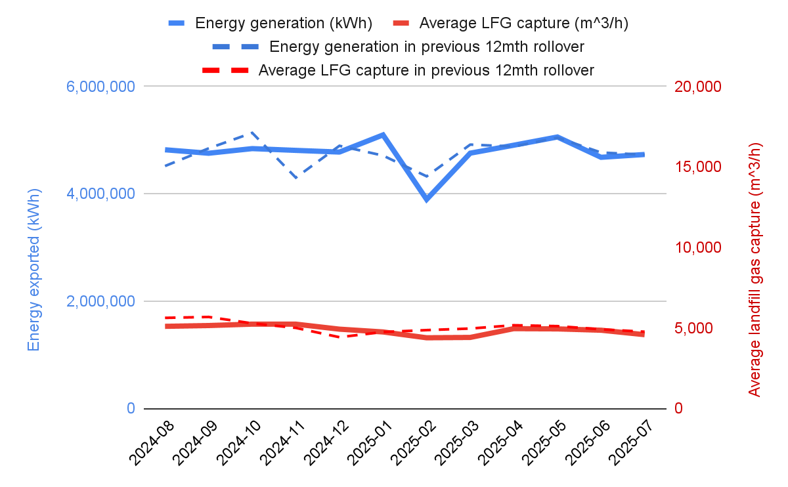
ECO-PRECINCT OPERATIONAL UPDATE
BIO-ENERGY
Bioenergy
2025 Biogas Capture
Gas collected 01/25-07/25: 23,905,982 m³ - (46% methane)
Energy Generation 01/25-07/25: 33,130 MWh
In 2025, the captured emission is equivalent to removing 78,161 cars off the road
Notes:
As per slide.

Slide 15
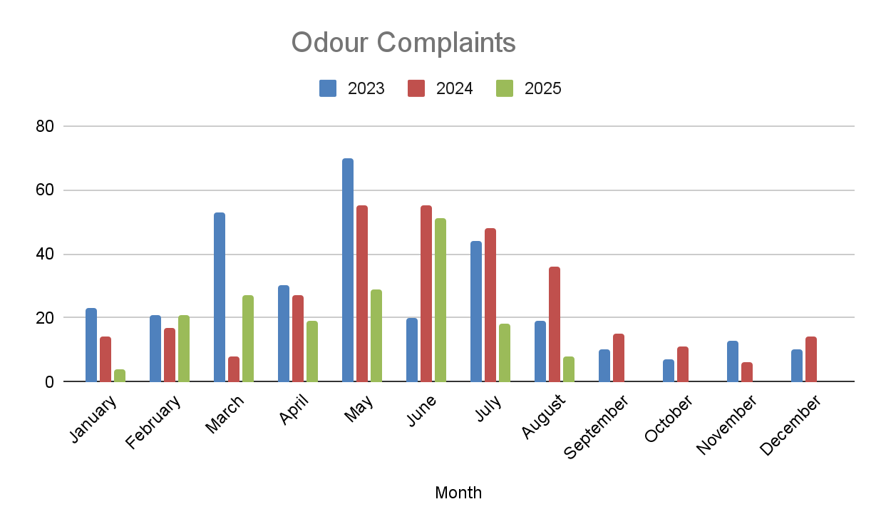
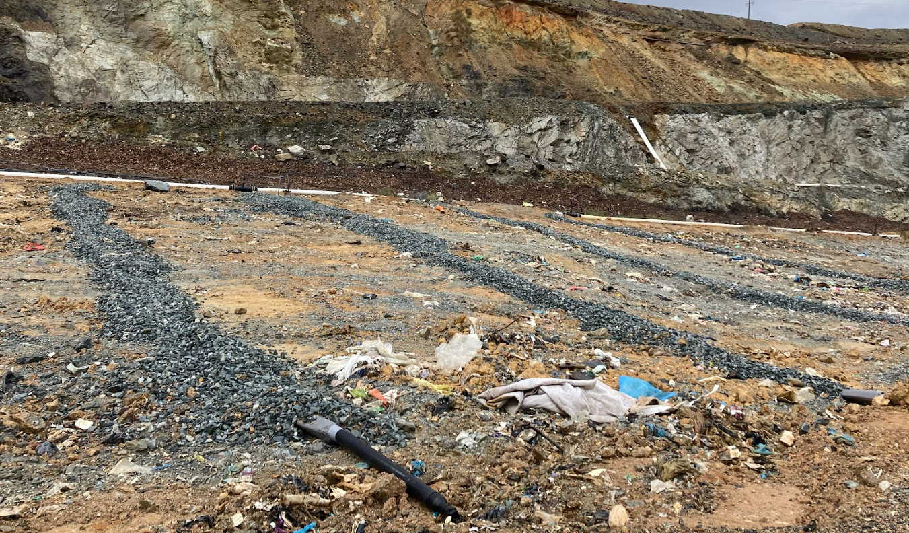
ECO-PRECINCT OPERATIONAL UPDATE
ODOUR COMPLAINTS
Odour complaints, on average, have reduced significantly during the July and August period compared to the last two years.
Focus on implementing tipping face Tarp cover trial, and biofilter improvements comprehensively during winter
Independent Odour Audit did show a large decrease in sitewide total odour (OER), may be related
2024: 749,000 OER
2025: 194,400 OER
Sub-surface extraction trench
Notes:
As per slide.

Slide 16
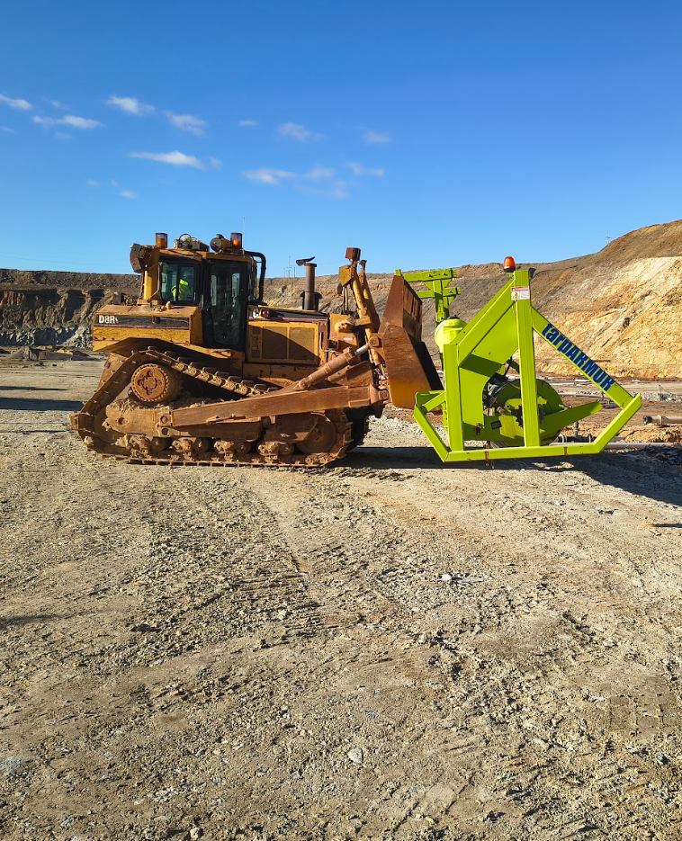
ECO-PRECINCT OPERATIONAL UPDATE
ODOUR MANAGEMENT
COMPLETE
Approval to increase usage of MBT organic material for daily cover.
Monthly surface monitoring - continue 0 exceedance in last month (out of 300+ sample sites)
Carbon filters operating along the eastern wall
Horizontal collection systems
Water used to maintain moisture in the cover to prevent cracking and improve gas collection (refer R3 vs Mod 7 response)
In Progress - 3 main potential odour improvements for 2025
Further improving landfill cover in the active tipping area - Tarp deployer assembled - trial conducted and odour measurements taken.
Improve effectiveness of biofilter around perimeter - moisture level and width and thickness - ongoing.
Notes:
As per slide.

Slide 17
ENVIRONMENTAL COMPLIANCE UPDATE

Slide 18
ENVIRONMENTAL COMPLIANCE UPDATE HRA and EPA sampling update
The sampling was conducted as a rapid response program and is a snapshot in time of surface water conditions around the Precinct and is in no way representative of locations downstream. The results of this program are used to inform a broader program to assess water quality in the area. - EPA
EPA managing this program and we are informed
Latest Report was put on EPA website and we were informed that the EPA will notify the community

Slide 19
Environmental Compliance
Additional license conditions
ACTION | STATUS | COMPLETION DATE
New license conditions U3.7 Develop a scientifically robust program of sampling the local area and assess the background and adjacent areas. See if there are any impacts to fauna/flora from current or historical activities. | Received license conditions to verify status of nearby area near the Precinct. This includes the requirements for ecological studies done in a broad area, similar to the modern day requirements for new developments. These studies will comprehensively close out whether there are any potential impacts and if anything needs to be done.
Notes:
The site has been industrial activity right back to the open cut mine days, and now there is a operational mine nearby too. Baseline surveys needed to be done eventually.
The creeks are in good condition. We can take people on a tour to see the prawns, which are highly sensitive, in Alli creek (insert no eating prawns joke).

Slide 20
INDEPENDENT ODOUR AUDIT UPDATES
ACTION | STATUS | COMPLETION DATE
2024 Independent Odour audit | Received and shared with CLC. Pending actions are to resample the MBT biofilter and MBT stockpile (compost/MWOO facility) which were higher than last year. Recommendations include continued stormwater management in the void, facilitating leachate extraction with major projects for storage, treatment and reuse. We also are actively implementing the Tarp trial now with positive results from so far and are currently increasing biofilter placement Validation results by The Odour Unit of MBT anomaly show low readings. Sitewide Odour profile Total for previous Audit: 749,000 OER Total for this Audit: 194,400 OER | June 2025
Notes:
One stockpile set was high at MBT during the IOA. Validation results by The Odour Unit of MBT anomaly show low readings. Good result. All improvement actions completed.

Slide 21
ENVIRONMENTAL COMPLIANCE UPDATE PA MODIFICATIONS & POST APPROVAL APPLICATIONS
APPROVAL | TYPE | DESCRIPTION | STATUS
MP 10_0012 | Modification | Modify the existing project approval for the Bioreactor and MBT to: Originally to construct an approximately 100 ML dam at the Bioreactor to hold leachate pumped from the existing approved leachate dams via a pipeline. Changed to enclosed tanks following feedback about odour (Tank Farm 1 Mod 6) | Submission with DPHI
MP 10_0012 (Bioreactor) | Modification | Reverse Osmosis for beneficial reuse. High expenditure water treatment plant that will facilitate significantly improved treatment of treated leachate. Brine will report to the existing dams and possibly tanks. Beneficial reuse of the drinking quality water for the water carts, irrigation to the onsite farm, washdown processes, operational processes (Mod 7) | Submission with DPHI
MP 10_0012 (Bioreactor) | Management Plan change | Improvement of old contaminated mine area. Goal to prevent rainfall being contaminated in that area. | Investigating options for catchment diversion. Also now a license condition to investigate remedial options.
Notes:
We have been looking to what can be done for PCD area for a while. It’s a license condition now but we have made progress installing a new monitoring bore nearby.

Slide 22
ENVIRONMENTAL COMPLIANCE UPDATE PA MODIFICATIONS & POST APPROVAL APPLICATIONS
APPROVAL | TYPE | DESCRIPTION | STATUS
MP 10_0012 (Bioreactor) | Modification (TBC) | Thermal treatment facility. Thermally treat brine and treated leachate liquid using waste heat from the existing on-site power station. Will provide a weather independent method of managing certain liquid streams. | In pre-feasibility studies Site specific analytes being developed for a trial
MP 10_0012 (Bioreactor) | Modification | Tank Farm 2 - buffer storage for leachate storage while treatment facilities come online. Similar to Tank Farm 1 configuration. | Investigative heritage and ecological studies being undertaken, favourable preliminary findings

Slide 23
ARC PROJECT UPDATE

Slide 24
ARC Project UPDATE
Planning Progress
The NSW EPA continues its review of the Energy from Waste Policy Framework.
Veolia continues to explore what it will mean for the Woodlawn ARC and its upcoming reports and technical studies
We will keep the community informed of any developments and provide updates as new information becomes available
NSW Inquiry to EfW - Veolia welcomes and values this inquiry as an opportunity for continued engagement

Slide 25
GENERAL BUSINESS

Slide 26
General Business
Max Rixe new facilitator
Draft CLC Charter - Ready for review

Slide 27
ECO-PRECINCT
20 YEAR VISION FOR WOODLAWN
We will shortly be releasing a community flyer to show what we’ve achieved in the past 20 years of Woodlawn and to highlight our key areas of focus for the next 20 years. These areas of future focus include:
Operational improvements: We’ll continue to develop and invest in technology to improve our operations. From gas collection and odour management, to waste treatment, energy efficiency and much more.
Water Treatment: We’ll continue to find solutions to manage and treat on-site water, and accelerate evaporation capacity.
Rehabilitation efforts: We’ll continue to depollute the land impacted from mining activities, undertake more remediation works, such as tree planting, stabilising soils and removing old mining infrastructure.
Energy from Waste: We propose to build an Advanced Energy Recovery Centre to reduce waste to landfill.
Improving Biodiversity: We will be looking at ways to enhance local biodiversity, monitoring the creek and local wildlife and creating ways to protect their habitats.
More renewable energy: We’ll investigate ways to expand the site’s renewable wind and solar energy capacity, to supply more green energy to our operations and the grid.
The flyer is in the final stages of design and will be shared with the CLC and wider community in the next few weeks.
Notes:
As per slide.

Slide 28
COMMUNITY Q&A

Slide 29
CLC
QUESTIONS
List of questions have been sent to Veolia - will be answered with the minutes
Are there any questions for Veolia from the CLC

Slide 30
CLC
NEW ACTIONS
ACTION | STATUS | COMPLETION DATE
INSERT TEXT | Insert text | Insert tex

Slide 31
NEXT MEETING
The next Community Liaison Meeting will be held at the Woodlawn Eco-Precinct Office - TBC agreed.

Slide 32
VISION FOR WOODLAWN appendix 1

